Slide 1
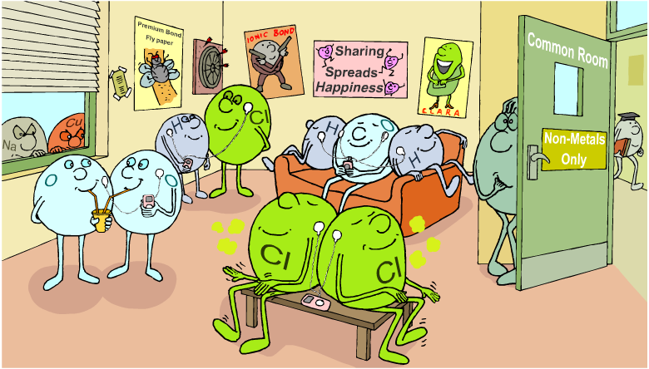
Covalent Bonding
Unit 2
Lesson 5

Slide 2
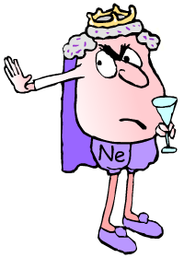
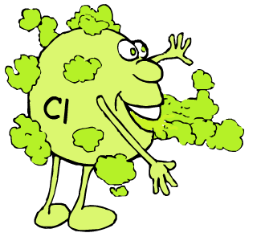
Recap: why do atoms form bonds?
The atoms of noble gases have completely full outer shells and so are stable.
This makes the noble gases very unreactive and so they do not usually form bonds.
The atoms of all the other elements have incomplete outer electron shells and so are unstable.
By forming bonds, the atoms of these elements are able to have filled outer shells and become stable.

Slide 3
Today’s Aim
Unit 2
Lesson 5
By the end of this lesson I will be able to use dot and cross diagrams to represent covalent bonding in molecules

Slide 4
What does the prefix ‘co-’ mean?
What does ‘co-’ mean?
cooperation
cohabit
By the end of this lesson I will be able to use dot and cross diagrams to represent covalent bonding in molecules
‘co-’ means to ‘share’. What do you think is being ‘shared’ in covalent bonding?

Slide 5
How are covalent bonds formed?
Notes:
What the picture shows:
The common room is only for non-metals – no metals allowed - Covalent bonding only occurs between non-metals.
iPod sharing - indicating the presence of covalent bonds. The iPods represent shared electrons. All the elements sharing iPods are happy indicating they are stable.
iPod and drink sharing between oxygen atoms - Indicating the presence of a double covalent bond.
Unstable non-metal atom not bonded to anything else - Non-metals need to bond to become stable (apart from the noble gases).

Slide 6
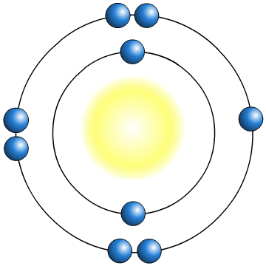


Covalent Bonding
Non-metal elements usually just need one or two electrons to fill their outer shells. So how do they form a bond?
F
incomplete outer shells
F
The two non-metal atoms cannot form a bond by transferring electrons from one to another. Instead, they share electrons.
F
F
Each atom now has a full, stable outer shell.

Slide 7
Covalent Bonding
Copy these notes onto the blank page 29
A covalent bond consists of a shared pair of electrons.
F
F
covalent bond
Note:
When drawing a covalent bond, there must always be a dot and a cross next to each other (i.e. a shared pair of electrons).

Slide 8

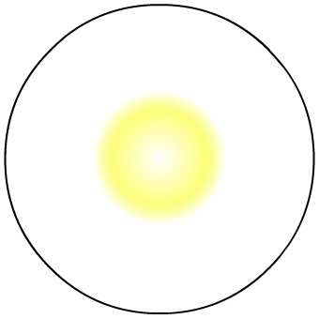

Covalent Bonding
Only outer shells of electrons are involved in bonding, so the inner shells do not always have to be included in diagrams. Some common ways to represent a covalent bond are:
F
F
dot and cross diagram
–
solid line
F
F
–
F
F

Slide 9
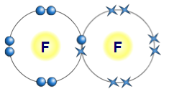
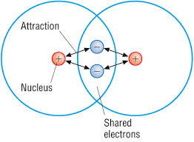
How does the covalent bond work?
not to scale

Slide 10
How does the covalent bond work?
Atoms in a covalent bond are held together by strong electrostatic forces of attraction between the positively charged nuclei and the negatively charged shared pair of electrons
-
+
+
-

Slide 11
How might hydrogen (H₂) bond?
Hydrogen exists as a molecule of two atoms bonded together. The formula for hydrogen gas is H₂.
TO DO:
On a mini whiteboard, draw a dot-cross diagram for a covalently bonded hydrogen molecule.
Using the model kits, build a hydrogen molecule (white = hydrogen atom).

Slide 12
How might chlorine (Cl₂) bond?
Chlorine also exists as a diatomic molecule with the formula for chlorine gas being Cl₂.
TO DO:
On a mini whiteboard, draw a dot-cross diagram for a covalently bonded chlorine molecule. Draw outer electrons only.
Build a chlorine molecule. (green = Group 7 elements)

Slide 13
Hydrogen chloride
The formula for hydrogen chloride is HCl.
TO DO:
On a mini whiteboard, draw a dot-cross diagram for a covalently bonded hydrogen chloride molecule. Draw outer electrons only.
Using the model kits, build a molecule of HCl.

Slide 14
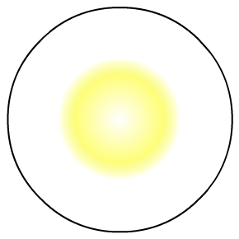
Covalent Bonding
Covalent bonding can also occur between atoms of different non-metals to create molecules of covalent compounds.
The covalent bond formed in hydrogen chloride, HCl, can also be represented as H–Cl
H
Cl
H
Cl
Hydrogen and chlorine both need one more electron to fill outer shells. By sharing one electron each, they both have a stable outer shell and a covalent bond is formed.

Slide 15
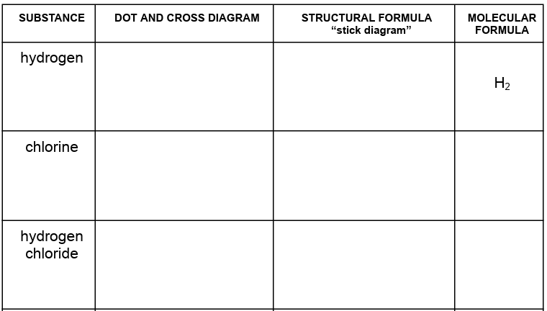
Covalent Bonding (page 30)
‘Sticks’ represent the bonds

Slide 16
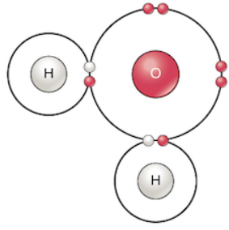
Covalent bonding in water
Compounds can contain more than one covalent bond.
TO DO:
Draw a dot-cross diagram for a covalently bonded water molecule and build a model using white for hydrogen and red for oxygen.
O
H
H
The oxygen atom shares one electron with one hydrogen atom, and a second electron with a different hydrogen atom.

Slide 17
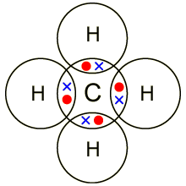
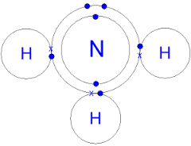
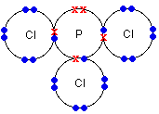
Covalent bonding - page 30
Try the following:
methane, CH₄
ammonia, NH₃
phosphorus chloride, PCl₃

Slide 18
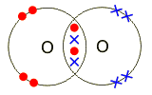

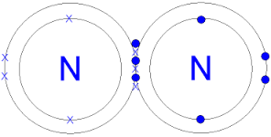
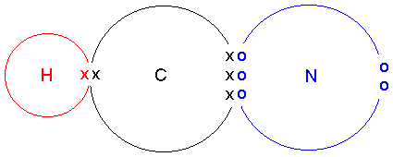
Use the mini whiteboard first!
Now draw these:
oxygen, O₂
carbon dioxide, CO₂
nitrogen, N₂
hydrogen cyanide, HCN

Slide 19
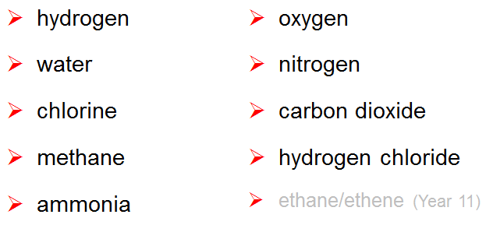
Make sure you can!
You need to be able to draw dot and cross diagrams for each of these molecules

Slide 20
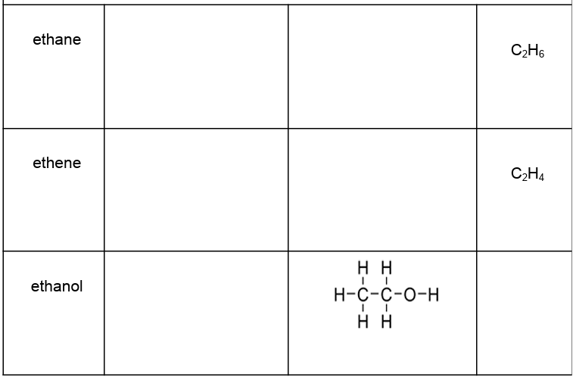
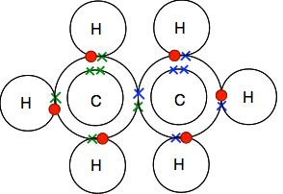
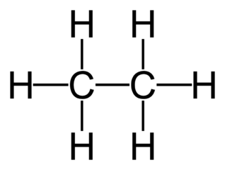
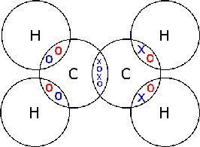
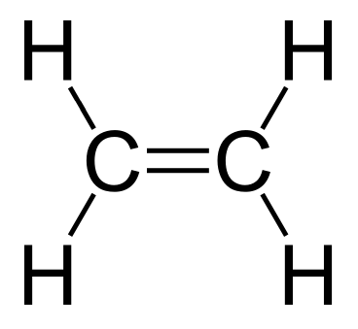
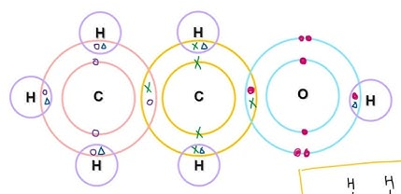
Extension (will be covered in Y11)
C₂H₅OH

Slide 21
Plenary: some more to practise with
If you can do the ones that the exam board expects you to be able to do, you should be able to do lots of different covalent molecules. For example, these three only contain single bonds:
SiH₄ N₂H₄ CH₃CH₂OH
The next two contain at least one double bond:
CH₂O NOCl

Slide 22

What you need to know
Unit 2
Lesson 5
Syllabus Content:
1.44
know that a covalent bond is formed between atoms by the sharing of a pair of electrons.
1.45
understand covalent bonds in terms of strong electrostatic forces of attraction
1.46
understand how to use dot-and-cross diagrams to represent covalent bonds in:
• diatomic molecules, including hydrogen, oxygen, nitrogen, halogens and hydrogen halides
• inorganic molecules including water, ammonia and carbon dioxide
(• organic molecules containing up to two carbon atoms, including methane, ethane, ethene and those containing halogen atoms - later in Year 11)
My Learning

